Slide 1
Distributed File Systems
Presented By:
Tirtha Bhattarai
Nabina Chaulagain

Slide 2
Introduction
A Distributed File System stores files across multiple machines (nodes) but makes them appear as if they are stored in one single system.
Instead of saving a big file on one computer:
Break it into parts
Store parts on different machines
Access it like a normal file

Slide 3
Why DFS?
Handle huge data (Big Data)
Improve fault tolerance
Increase performance
Enable parallel processing

Slide 4
Example
Google Drive:
Your file is not stored on one server
It is distributed across many servers worldwide
If one server fails, your file is still safe

Slide 5
Google File System (GFS)
The Google File System (GFS) is a scalable distributed file system developed by Google to store and manage huge amounts of data across thousands of machines.
It is specially designed for data-intensive applications like search engines, YouTube, and big data analytics.
GFS was built to handle very large files (GBs to TBs), Frequent failures.

Slide 6
GFS Architecture
GFS follows a Master - Slave architecture with three main components:
Master:
Stores metadata, i.e. File names, Chunk locations, Access permissions.
Controls the system but does not store actual file data
Chunk Servers:
Store actual data in the form of chunks
Each chunk is typically 64 MB
Each chunk is replicated (usually 3 copies)

Slide 7
GFS Architecture
Clients:
Applications that request data
Communicate with:
Master => for metadata
Chunk servers => for actual data

Slide 8
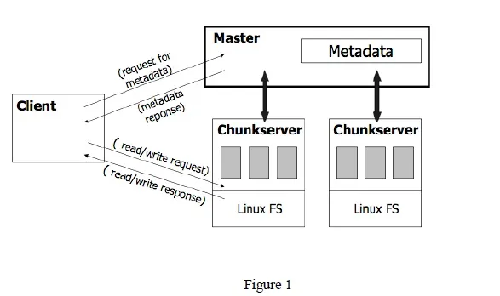
GFS Architecture

Slide 9
Google File System (GFS)
Analogy of GFS like a warehouse system:
Master = Manager (knows where everything is)
Chunk Servers = Storage units
Client = Customer requesting items
Even if one storage unit fails items are still available elsewhere.

Slide 10
Working of GFS
File Write Process:
Client asks Master for chunk locations
Master responds with chunk server details
Client writes data directly to chunk servers
Data is replicated across multiple servers
File Read Process:
Client asks Master for chunk location
Master returns chunk server info
Client reads data directly from chunk server

Slide 11
Advantages of GFS
High Fault Tolerance: Uses replication to ensure data is available even if nodes fail.
Scalability: Can handle thousands of machines and petabytes of data.
High Throughput: Optimized for large data processing and streaming.
Efficient for Large Files: Works best with very large files (GBs/TBs).
Automatic Recovery: Detects failures and re-replicates data automatically.
Supports Concurrent Access: Multiple clients can read and append data efficiently.

Slide 12
Limitation of GFS
Single Master Bottleneck: Master node can become a performance and failure bottleneck.
Not Suitable for Small Files: Inefficient when handling many small files.
High Latency for Small Operations: Not optimized for quick, small read/write tasks.
Complex Management: Requires careful handling of distributed infrastructure.

Slide 13
The Hadoop Distributed File System (HDFS)
The Hadoop Distributed File System (HDFS) is a key component of the Apache Hadoop ecosystem, designed to store and manage large volumes of data across multiple machines in a distributed manner.
It provides high-throughput access to data, making it suitable for applications that deal with large datasets, such as big data analytics, machine learning, and data warehousing.

Slide 14
HDFS Architecture
HDFS is designed to be highly scalable, reliable, and efficient, enabling the storage and processing of massive datasets.
Its architecture consists of several key components:
NameNode (Master): Manages HDFS metadata and tracks the location of data blocks across DataNodes.
DataNode (Slaves): Stores actual data blocks and handles read/write operations in HDFS.
Secondary NameNode: Periodically merges metadata to assist the NameNode and improve system performance.
HDFS Client: Communicates with NameNode and DataNodes to perform file operations.
Block Structure: Splits large files into fixed-size blocks stored and replicated across multiple nodes.

Slide 15
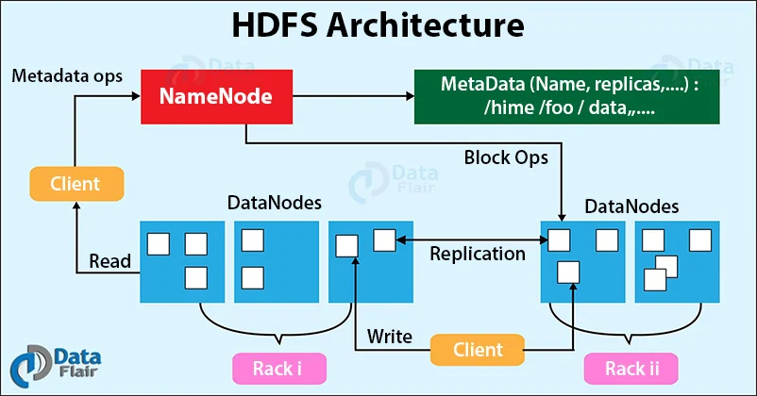

Slide 16
Working of HDFS
File is split into blocks (e.g., 128MB)
Each block is stored on different DataNodes
Blocks are replicated (default = 3 copies)

Slide 17
Advantages & Limitations of HDFS
Advantages:
Fault Tolerance: If one node fails, data is still available.
Data Locality: Processing happens where data is stored
High Throughput: Good for large data, not small files
Limitations:
Single NameNode failure risk
Poor performance for small files

Slide 18
CEPH
CEPH is an open-source distributed storage system designed to provide high scalability, reliability, and performance without a single point of failure.
It supports object storage, block storage, and file systems in one unified platform.

Slide 19
Why Ceph?
Ceph is designed to:
Handle massive amounts of data
Avoid central bottlenecks
Provide self-managing and self-healing storage
Work efficiently in cloud and data center environments

Slide 20
CEPH Architecture
OSD (Object Storage Daemon)
Stores actual data (objects)Handles read/write operations
Manages replication and recovery
MON (Monitor)
Maintains cluster state (health, nodes, configuration)
Ensures consistency across the system
MDS (Metadata Server)
Manages metadata for Ceph File System (CephFS)
Handles file names, directories, permissions

Slide 21
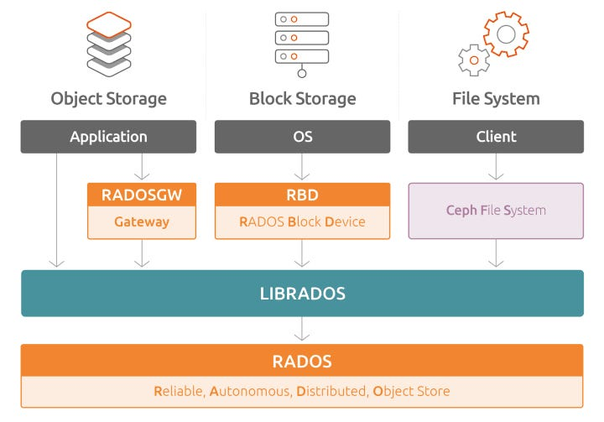
CEPH Architecture

Slide 22
CRUSH Algorithm
Ceph uses the CRUSH (Controlled Replication Under Scalable Hashing) algorithm to:
Decide where data should be stored
Distribute data evenly across nodes
Clients can directly calculate data location without asking a central server.

Slide 23
Advantages of CEPH
No Single Point of Failure: Fully distributed architecture eliminates central bottlenecks.
Highly Scalable: Can easily scale from a few nodes to thousands.
Self-Healing: Automatically detects failures and recovers lost data.
Automatic Rebalancing: Redistributes data when nodes are added or removed.
Unified Storage System: Supports object, block, and file storage in one platform.
Efficient Data Distribution: Uses CRUSH algorithm for intelligent data placement.

Slide 24
Limitations of CEPH
Complex Setup: Installation and configuration can be difficult.
High Resource Usage: Requires more CPU, memory, and network bandwidth.
Performance Overhead: Can be slower in small-scale systems.
Steep Learning Curve: Harder to understand and manage compared to simpler systems.
Network Dependency: Performance heavily depends on network quality.

Slide 25
Thank you!!!

